Slide 1
CSS Layouts
Front-End Web Development

Slide 2
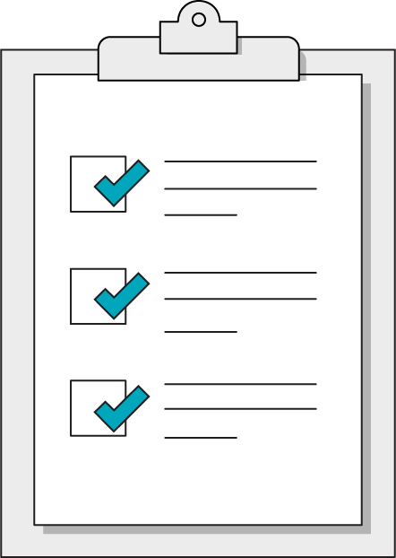
Today’s Learning Objectives
In this lesson, you will:
Link to files from HTML using relative paths.
Apply normalizing CSS to avoid browser default styling interference.
Use margins and padding to create spacing between elements.
Set the display property of elements to create page layouts.
‹#› | © 2020 General Assembly

Slide 3
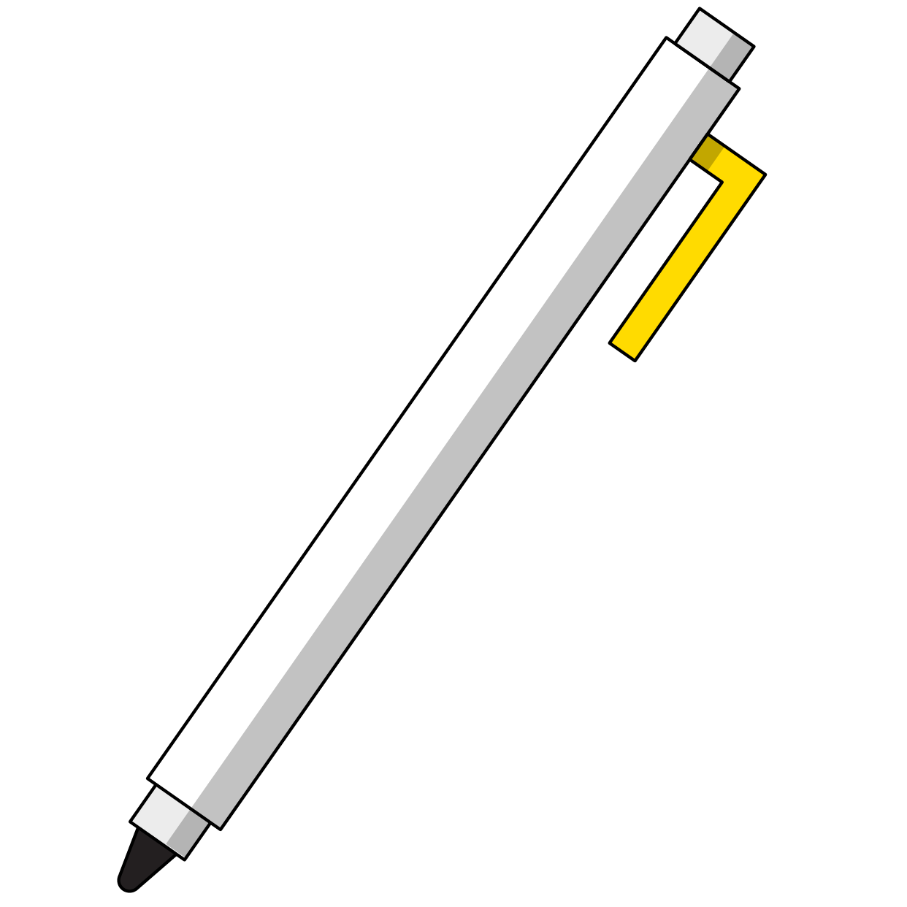
Quick Review
What are the two major types of HTML tags?
What are the three parts of a CSS declaration?
What are some CSS selectors we’ve learned?
Who has explored some CSS properties since last class?

Slide 4
Cascading: What Does It Mean?
Front-End Web Development

Slide 5

Think of the Document Tree as a Real Tree
<main>
<section>
<div class=“green-font”>
Content A
</div>
<div>
Content B
</div>
</section>
</main>
DOM Tree
Real Tree
‹#› | © 2020 General Assembly

Slide 6
What If I Apply My Styles at Each of These Spots?
<div class=“leaves”>
<main>
‹#› | © 2020 General Assembly

Slide 7
<main> Styles the Whole Tree — .leaves Styles a Small Leaf
<div class=“leaves”>
<main>
‹#› | © 2020 General Assembly

Slide 8
Classes & IDs
Front-End Web Development

Slide 9
Class & ID
With classes and ids we can target specific elements on a page, so we can manipulate it uniquely.

Slide 10
Defining a Class or ID
Classes and IDs are defined as attributes
They must start with a letter
They can contain letters, numbers, the hyphen (-), and underscore (_)
<p class=”featuredText”>Many Products</p>
Class Name

Slide 11
Defining a Class or ID
Classes and IDs are defined as attributes
Id’s are UNIQUE on a page
Classes can be used many times on a page
<p id=”theUsername”>GaiusMarius</p>
ID Name

Slide 12
More Advanced Selectors
Front-End Web Development

Slide 13
Selectors Targeting Multiple Attributes
div.my-class {
color: white;
text-decoration: underline;
}
You can also combine several selectors together in order to target only the elements that match all of the selectors included. The example above targets only div elements with the .my-class class.
Notice that there is no space between div and .my-class.
‹#› | © 2020 General Assembly

Slide 14
Specific selectors override general selectors:
ID > Class > Element
‹#› | © 2020 General Assembly

Slide 15
!important
.make-it-white {
color: white !important;
text-decoration: underline;
}
Using !important makes this style jump out of the DOM tree order and take precedence over all other styles.
If you use this in your work regularly, code reviewers will not be happy. This is considered a brute-force, last-resort approach when all other selectors have failed.
‹#› | © 2020 General Assembly

Slide 16
CSS Exploration
30 minutes
This exercise is to practice writing specific selectors to apply styles. Remember, there’s more than one right answer!
Starter code:
https://drive.google.com/drive/folders/1K_Whx2c2PQK2QfQu7h9uyNjdLRaUSdRC?usp=sharing
Solution code:
https://drive.google.com/drive/folders/1K_Whx2c2PQK2QfQu7h9uyNjdLRaUSdRC?usp=sharing
‹#› | © 2020 General Assembly

Slide 17
CSS Exploration
30 minutes
In the exercise folder, open the README.md in Visual Studio Code for a list of specific styles to create
‹#› | © 2020 General Assembly

Slide 18
Structuring HTML
Front-End Web Development

Slide 19
The DOM Tree
A visual diagram of a webpage’s HTML structure.

Slide 20
Tree-Like Structures Can Be Visualized
<main>
<section class=”ichi”>
<p>
Content
</p>
</section>
<section class=”ni”>
<p>
More content
</p>
</section>
</main>
p
section
p
section
main

Slide 21

How Is This Page Structured?
15 minutes

Slide 22
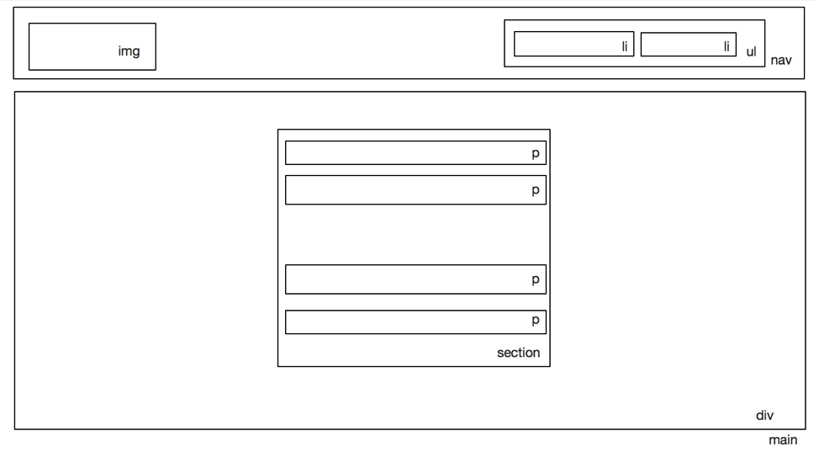
Remember: HTML Is Subjective (to Some Degree)

Slide 23
The Box Model
Front-End Web Development

Slide 24
CSS Box Model
As we discuss the details of the box model, you can reference the following CodePen for specific examples and illustrations of each concept:
Reference code:
https://drive.google.com/drive/folders/1VAZyify_6c48UlN4iKmBfIPh4AMYY6xM?usp=sharing

Slide 25
The Box Model
margin-top
border-top
padding-top
width
background-color
margin-left
border-left
padding-left
height
padding-right
border-right
margin-right
padding-bottom
border-bottom
margin-bottom

Slide 26
Box Model Basics
Every element on a webpage is a box.
Elements have a padding, border, and margin.
width + padding + border = actual visible width of an element's box.
height + padding + border = actual visible height of an element's box.
margin is outside the box and does NOT count toward visible height and visible width.
margin-top
border-top
padding-top
width
margin-left
border-left
padding-left
height
padding-right
border-right
margin-right
padding-bottom
border-bottom
margin-bottom

Slide 27
CSS Display Property
Front-End Web Development

Slide 28
display
display controls the behavior of the box in which content sits. We’ll cover several of the most commonly used values of the display property:
block
inline
inline-block
none

Slide 29
Block vs. Inline Elements
Block-level elements fill the width content flow.
div, section, h1-h6, ul, ol, nav, header, footer
Inline-level elements do NOT fill the width nor have discrete margin.
a, span, img, button, sub, sup, b, em
You can apply display: block; to an inline element via CSS and it will become a block-level element (and vice versa).
Refer here for list of inline elements: https://developer.mozilla.org/en-US/docs/Web/HTML/Inline_elements

Slide 30
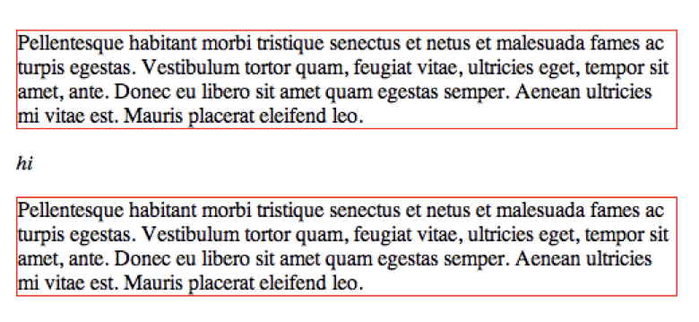
Positioning Elements: block
display: block;
This element takes up as much width as possible and the following element drops to a new line.
Image source; css-tricks.com

Slide 31
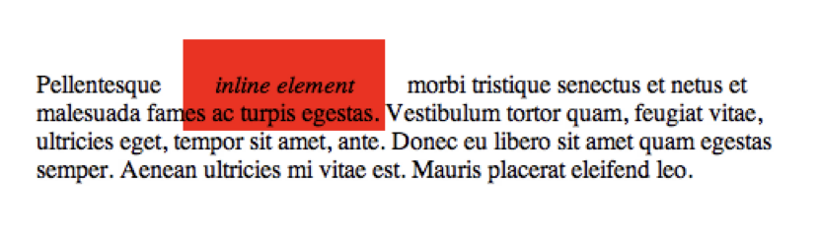
Positioning Elements: inline
display: inline;
This element takes up only as much width as it needs. Padding and margins only work for left and right, not top and bottom.
top and bottom spacing is controlled by the line-height property because the content is inline.
Image source; css-tricks.com

Slide 32
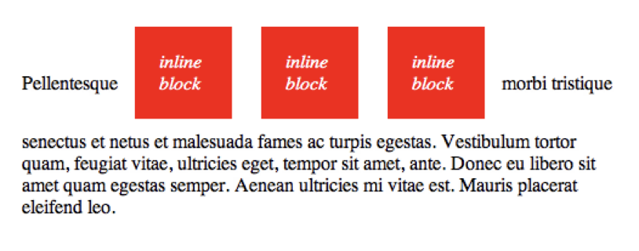
Positioning Elements: inline-block
display: inline-block;
This combines the two concepts.
Inline blocks display inline with other items but allow you to use all margin, padding, height, and width properties.
Image source; css-tricks.com

Slide 33

Positioning Elements: none
display: none;
Nothing shows up at all. It's in the DOM the browser sees, but the user won't see it. You can use Chrome DevTools to see the browser’s view.
This may seem useless now, but just wait until we hit JavaScript. You're going to love display: none.
Image source; css-tricks.com

Slide 34
Normalizing CSS
Front-End Web Development

Slide 35

Normalizing Output
Browsers all have their own unique ways of rendering things.
Very smart people have compared and contrasted these very minor differences and fixed them for you — how nice!
There are many of these fixes, but we’ll make your life simple and point you to the most popular one, Normalize CSS: http://necolas.github.io/normalize.css/.

Slide 36
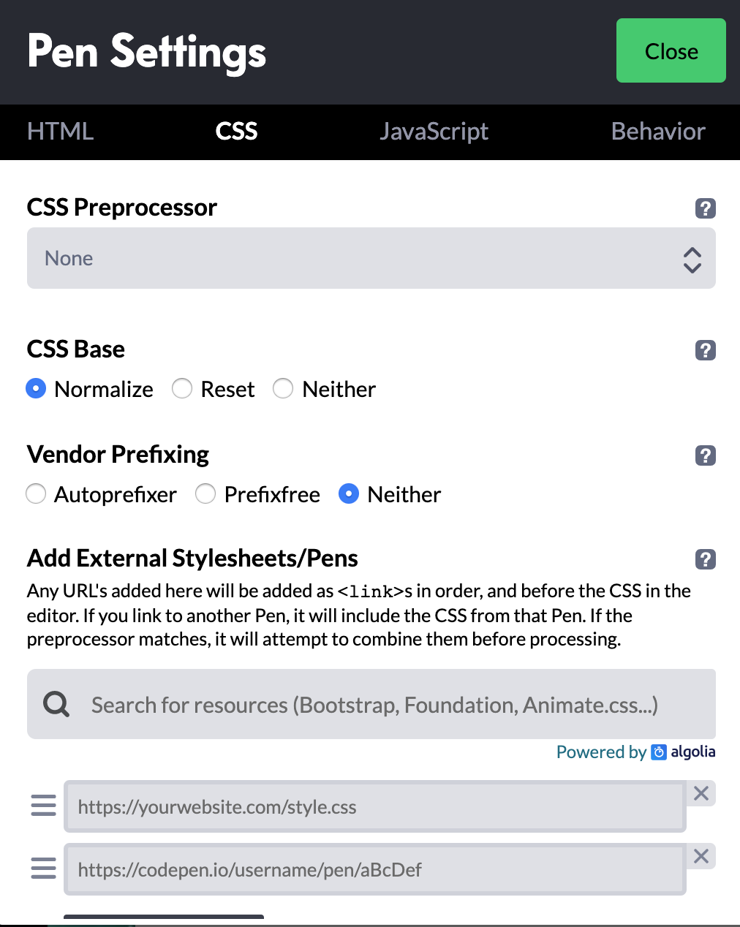
How to Use Normalize
<head>
<title>Something Unique</title>
<link rel="stylesheet" href="css/normalize.css">
<link rel="stylesheet" href="css/main.css">
</head>
Download Normalize.
Place Normalize CSS before your external CSS.
Code away like normal.
Note: In CodePen (see image), you use Normalize as a “CSS Base” by clicking the gear in the CSS panel.

Slide 37
Normalize vs. Reset
‹#› | © 2020 General Assembly

Slide 38
Use Normalize or Reset on this week’s homework!
‹#› | © 2020 General Assembly

Slide 39
Practicing the Box Model
60 minutes
Use what you have learned about the box model and selectors to create a style guide
Style guides are critical to all large scale projects
Open the project folder starter code: https://drive.google.com/drive/folders/1VAZyify_6c48UlN4iKmBfIPh4AMYY6xM?usp=sharing
The README.md file contains a list of necessary styles

Slide 40
Key Takeaways
For Next Time
Display and the Box Model
Layouts With Flexbox
Block elements have three key properties affecting their size and spacing:
padding
margin
border
The display property is used to set elements next to or on top of each other.
Flexbox creates dynamic, responsive layouts.

